Slide 1
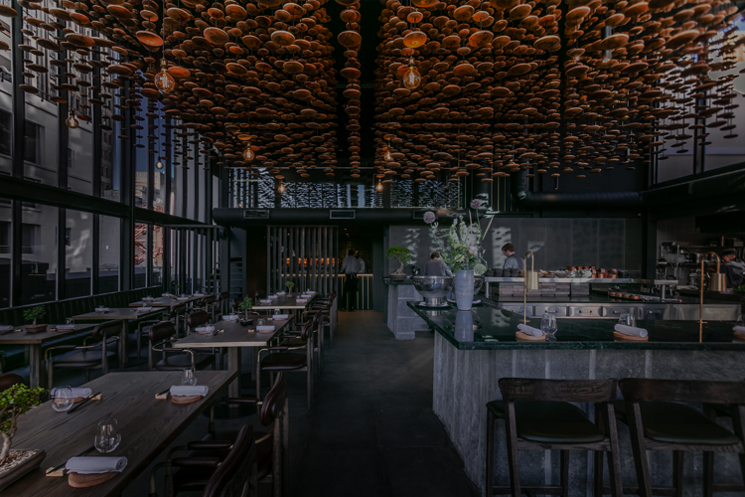

Slide 2


Restaurant Management System
C Programming Language

Slide 3
INTRODUCTION

Slide 4

INTRODUCTION
The restaurant management system is a program to manage, the data, orders and bills easily. It firstly shows the menu, places the order on behalf of customer directly to the counter/kitchen and generates the bill automatically and displays to the customer. This is a very easy to use program and can save a lot of time and effort which will improve the performance of the restro. This also has a unique interesting feature i.e. it also provides the option child package of food which ultimately costs 40% less than normal package and has comparatively less food.

Slide 5
OBJECTIVES

Slide 6
OBJECTIVES
To help record information of orders, sales, and invoices
To make recording information more efficient and effective.
To work smoothly and in an easy way.
To save time.

Slide 7
PROJECT FEATURES

Slide 8
PROJECT FEATURES
To be able to update timely and access current information:
To provide information:
Provides basic operation:
Preservation of data:

Slide 9
PROGRAM GENERATION

Slide 10


PROGRAM GENERATION

Slide 11
FLOWCHART

Slide 12
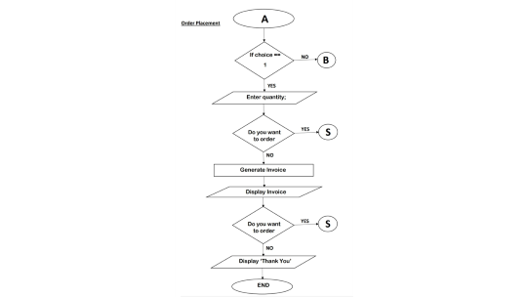
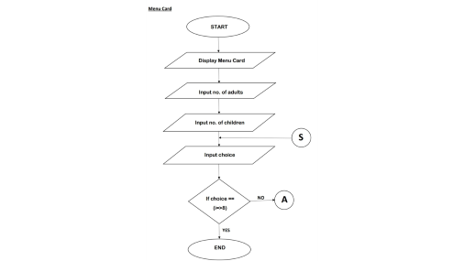
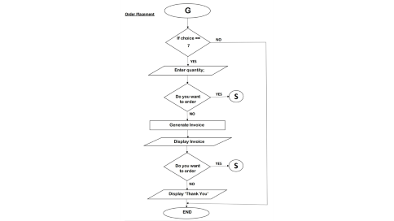
FLOW CHART

Slide 13
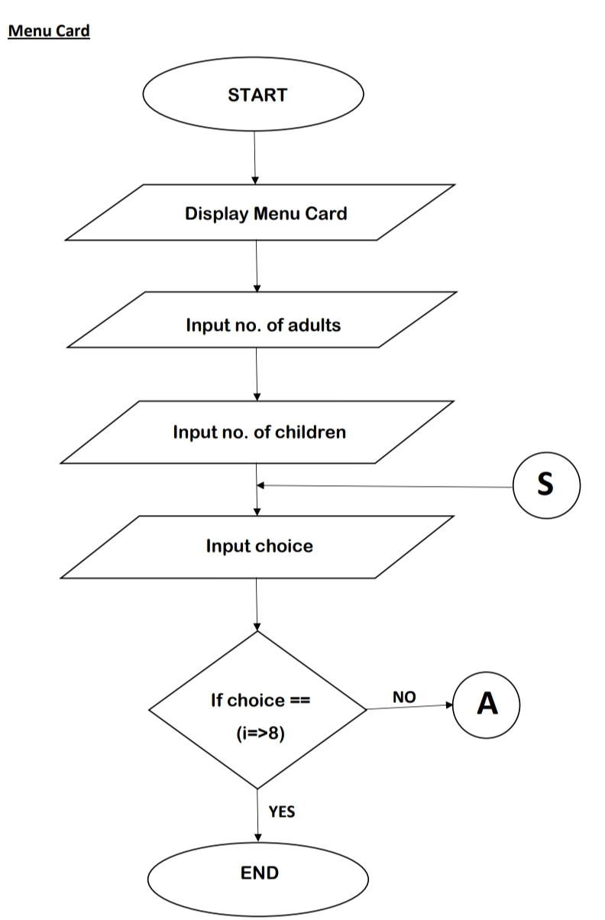

Slide 14
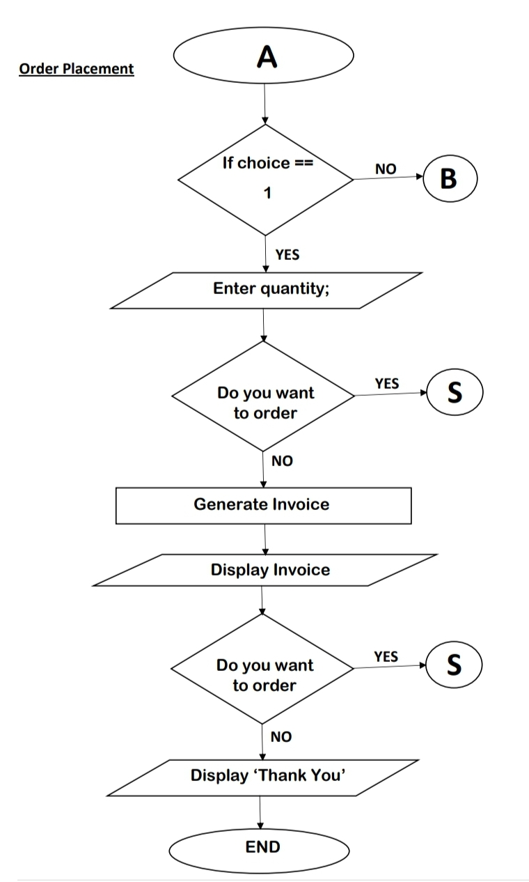

Slide 15
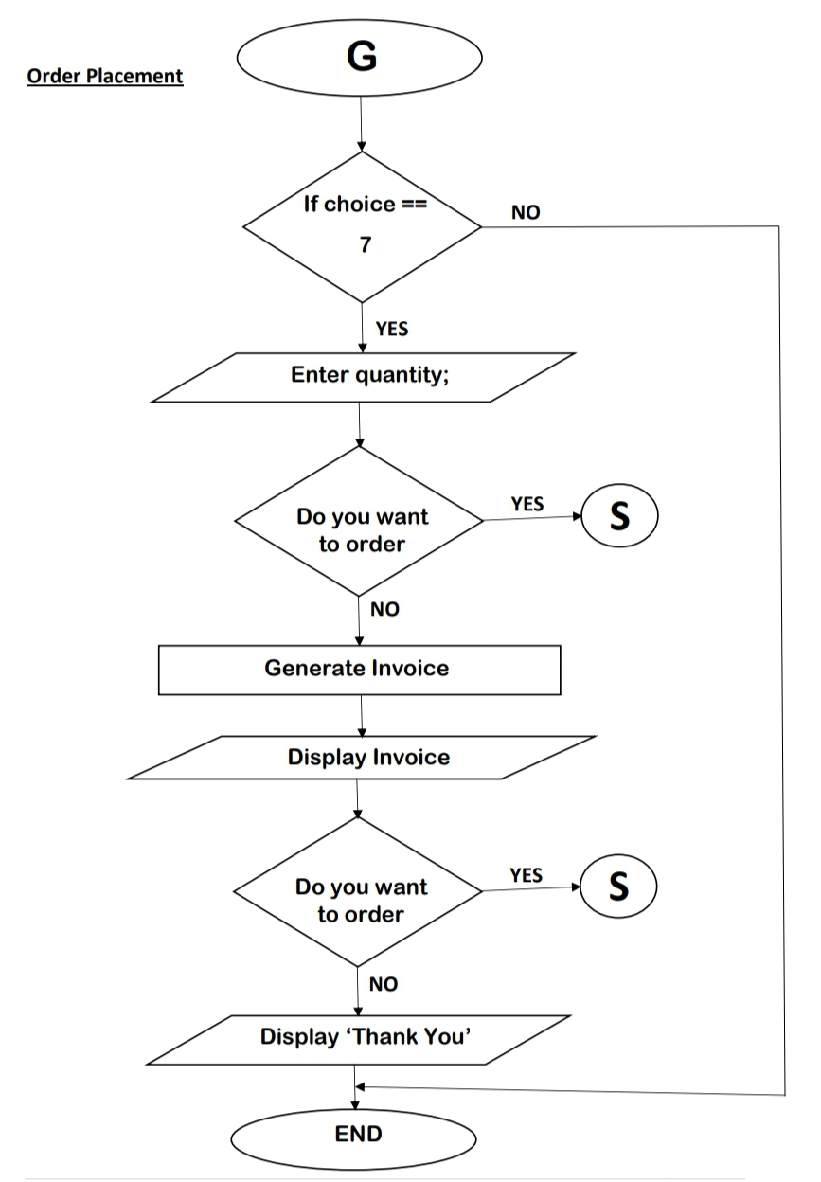

Slide 16
CODING

Slide 17
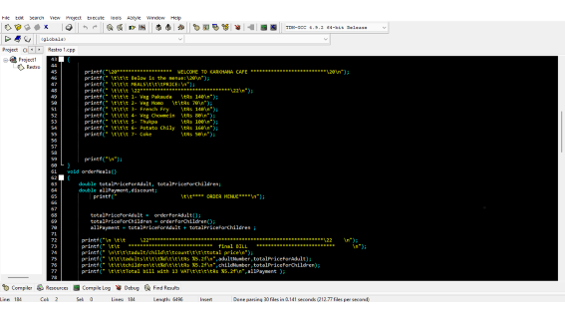
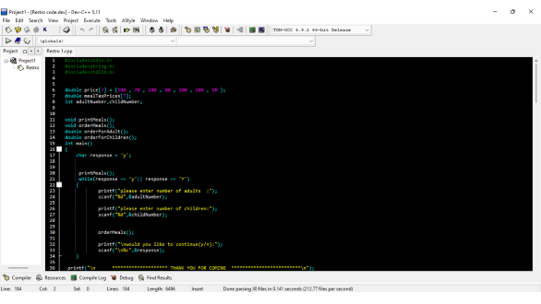
CODING

Slide 18
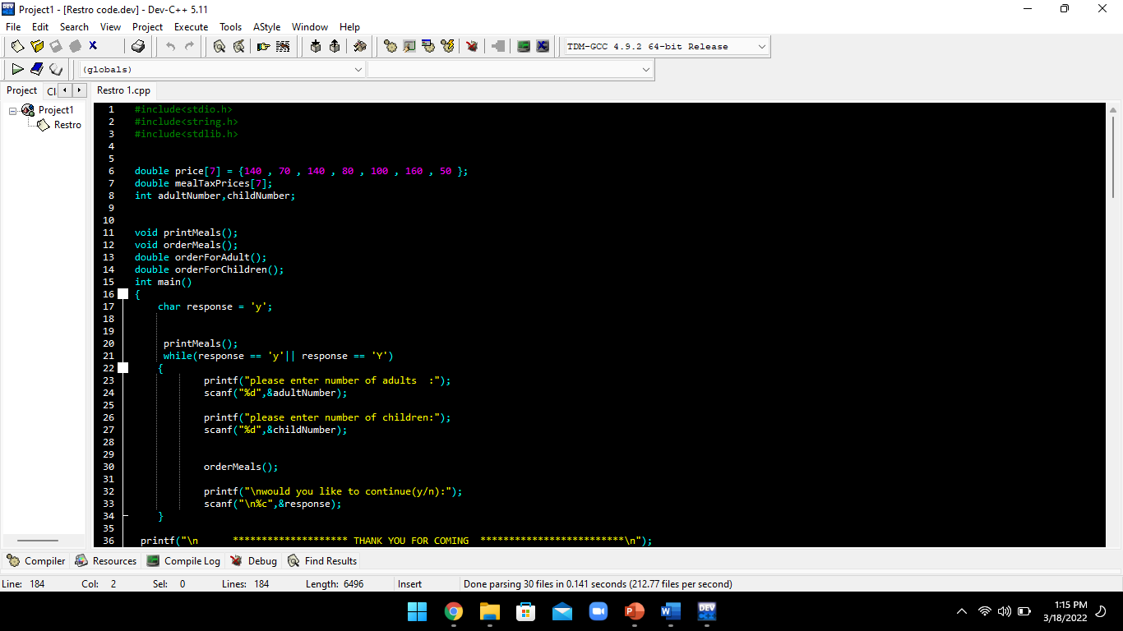

Slide 19
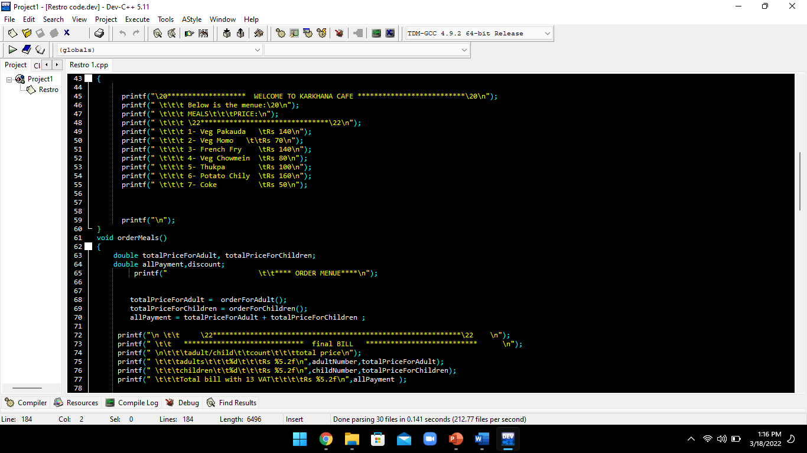

Slide 20
OUTPUT

Slide 21
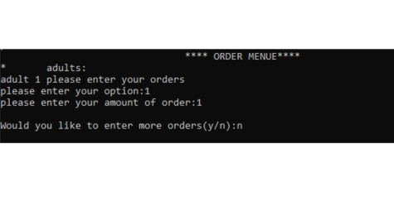
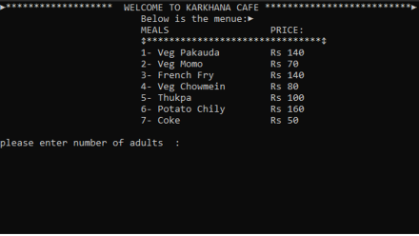
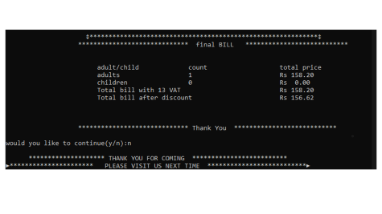
OUTPUT RESULTS

Slide 22
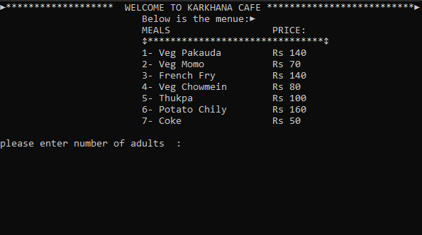

Slide 24
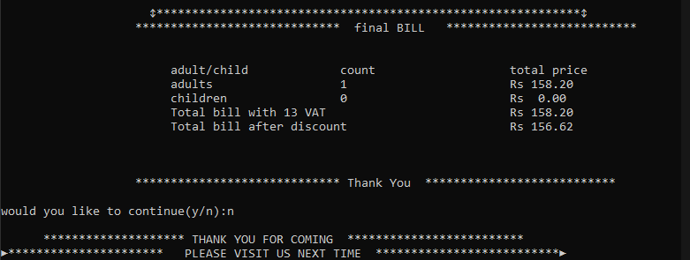

Slide 25
BIBLIOGRAPHY

Slide 26

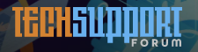


BIBLIOGRAPHY
Shekhar Sir

Slide 27

BIBLIOGRAPHY
THANK YOU SO MUCH EVERYONE

